Slide 1
932
932
Q
Can we adopt CSMA/CD (used in wired Ethernet) for use in wireless networks
MAC for wireless networks
Notes:
The answer is no (and will be clarified next).

Slide 2
The 802.11 MAC Layer Services
Some important services offered by an 802.11 Access Point (AP) are:
Service announcement using Beacon frames
Integration with the Internet
Association / Re-association
Reliability
Fragmentation
Authentication
Privacy
Image Courtesy of www.ieee802.org

Slide 3
The 802.11 MAC Layer Services: Authentication
Authentic: [m-w.org]
1 obsolete : AUTHORITATIVE 2 a : worthy of acceptance or belief as conforming to or based on fact <paints an authentic picture of our society> b : conforming to an original so as to reproduce essential features <an authentic reproduction of a colonial farmhouse> c : made or done the same way as an original <authentic Mexican fare> 3 : not false or imitation : REAL, ACTUAL <based on authentic documents> <an authentic cockney accent> 4 a of a church mode : ranging upward from the keynote -- compare PLAGAL 1 b of a cadence : progressing from the dominant chord to the tonic -- compare PLAGAL 2 5 : true to one's own personality, spirit, or character
Authentication: [m-w.org]
to prove or serve to prove the authenticity of
802.11 networks support two authentication modes:
Open-system: Why is this even called authentication?
Shared-key: All nodes and the AP share a common secret or a key
Notes:
Authentication is based on SSID’s in an open system authentication. See passive scanning, in which beacon frames are sent by the AP after every 100ms to show presence. By default, SSID comes with the beacon frames and can easily be discovered.
An attacker only needs to roam into different areas, accept the SSID in the beacon frame and get connected.

Slide 4
The 802.11 MAC Layer Services: Authentication
Association request
Node
AP
Randomly generated challenge text
Encrypted challenge text
Pre-authentication can be used to minimize handoff delays
Notes:
It is possible to derive the key-stream used for the handshake by capturing the challenge frames in Shared Key authentication.
Wi-Fi Protected Access (WPA) is the alternative which is now being used.

Slide 5
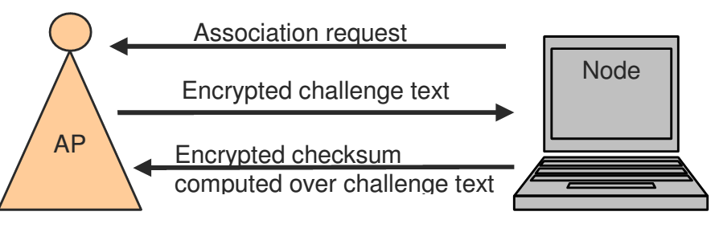
The 802.11 MAC Layer Services: Authentication - Solution
Possible Solution: The node sends an association request to the access point. The access point (AP) randomly generates a challenge text. But instead of
sending the challenge text to the node in plaintext, the AP encrypts the challenge text and then sends this encrypted challenge text to the node. The node decrypts the challenge text, computes the checksum of the challenge text, encrypts this checksum, and sends this encrypted checksum to the AP. The AP decrypts the checksum and compares it with a checksum that it has computed over the original challenge text that it generated. If the checksum is verified, the node is authenticated. The above procedure is shown pictorially below:
Notes:
It is possible to derive the key-stream used for the handshake by capturing the challenge frames in Shared Key authentication.
Wi-Fi Protected Access (WPA) is the alternative which is now being used.

Slide 6
The 802.11 MAC Layer Services: Privacy
Privacy: freedom from unauthorized intrusion [m-w.org]
In communication networks, the notion of privacy is to achieve three objectives:
Confidentiality: An eavesdropper should not be able to interpret the communication
Integrity: Any tampering of in-transit data should be detected
Authentication: Unauthorized nodes should not be allowed to use network resources [Discussed on previous slide]
These objectives are hard to achieve in wireless networks due to their broadcast nature

Slide 7
The 802.11 MAC Layer Services: Wired Equivalent Privacy (WEP)
802.11 networks use a Wired Equivalent Privacy (WEP) protocol to achieve privacy
WEP uses an encryption algorithm known as RC4 for confidentiality [Rivest cipher 4]
A 32-bit CRC checksum is used for integrity [discuss later]
Shared key authentication is used to authenticate nodes
All the higher layer headers (above the MAC header), the application data, and the integrity checksum are encrypted

Slide 8
The 802.11 MAC Layer Services: Wired Equivalent Privacy (WEP)
RC4 is a symmetric-key stream cipher
Symmetric-key: The encrypter (sender) and decrypter (receiver) share a common secret key
Stream cipher: Expand a short key into a pseudo-random keystream of the same length as the message (packet) to be encrypted
In 802.11, four keys can be stored and used
Keys of length 40 to 104 bits are supported

Slide 9
The 802.11 MAC Layer Services: Wired Equivalent Privacy (WEP)
<L
L
Key: k
RC4 Keystream Generator
(deterministic)
plaintext
L
keystream
L
Packet
XOR
ciphertext
L
Encrypted packet

Slide 10
The 802.11 MAC Layer Services: Wired Equivalent Privacy (WEP)
keystream
0
1
1
0
packet
1
0
1
0
1
1
0
0
channel
1
0
1
0
1
1
0
0
0
1
1
0
keystream
Can you spot a problem here?

Slide 11
The 802.11 MAC Layer Services: Wired Equivalent Privacy (WEP)
RC4 is a symmetric-key stream cipher
Symmetric-key: The encrypter (sender) and decrypter (receiver) share a common secret key
Stream cipher: Expand a short key into a pseudo-random keystream of the same length as the message (packet) to be encrypted
In 802.11, four keys can be stored and used
Keys of length 40 to 104 bits are supported

Slide 12
The 802.11 MAC Layer Services: Wired Equivalent Privacy (WEP)
<L
L
Key: k
RC4 Keystream Generator
(deterministic)
plaintext
L
keystream
L
Packet
XOR
ciphertext
L
Encrypted packet

Slide 13
The 802.11 MAC Layer Services: Wired Equivalent Privacy (WEP)
keystream
0
1
1
0
packet
1
0
1
0
1
1
0
0
channel
1
0
1
0
1
1
0
0
0
1
1
0
keystream
Can you spot a problem here?

Slide 14
The 802.11 MAC Layer Services: Wired Equivalent Privacy (WEP)
keystream
0
1
1
0
packet
1
0
1
0
1
1
0
0
keystream
0
1
1
0
Problem 1: If an eavesdropper knows the plaintext, he/she can generate the keystream.

Slide 15
The 802.11 MAC Layer Services: Wired Equivalent Privacy (WEP)
Intercepting Mobile Communications:
The Insecurity of 802.11
keystream
0
1
1
0
packet
1
0
1
0
1
1
0
0
1
1
0
1
keystream
1
1
0
1
0
1
1
0
packet
0
1
1
1
0
0
0
1
Problem 2: XOR of the plaintexts is equal to XOR of the ciphertexts.
Notes:
The disadvantage is that if the eavesdropper know any of the packet/plain text, then he can decrypt rest of the packets initialized with the same IV as of packet 1.

Slide 16
WPA -3
In January 2018, the Wi-Fi Alliance announced WPA3 as a replacement to WPA2. The new standard uses 192-bit encryption and individualized encryption for each user.
The Wi-Fi Alliance also claims that WPA3 will mitigate security issues posed by weak passwords and simplify the process of setting up devices with no display interface.
The protocol used by WPA2, based on the Advanced Encryption Standard (AES) cipher along with strong message authenticity and integrity checking is significantly stronger in protection for both privacy and integrity than the RC4 -based TKIP that is used by WPA.

Slide 17

Security attacks

Slide 18
What do we want to secure?
How secure will be secure enough?
What is someone still cracks the system?
How does the system recover after an attack?
Will the data be secure after an attack?
For how long will the services be suspended following an attack?

Slide 19
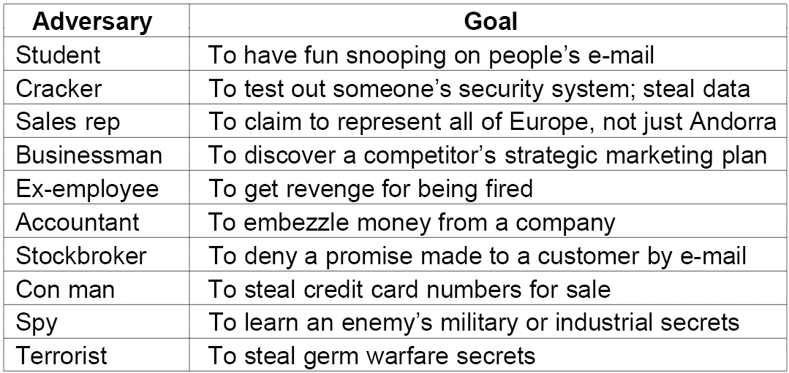
Motivation for security attacks
Source: “Computer Networks” by Andrew Tanenbaum
Notes:
Privacy:
Privacy means that the sender and the receiver expect confidentiality. The transmitted message must make sense only to the intended receiver and should be unintelligible to all others.
Authentication:
Authentication means that the receiver is sure of the sender’s identity and that an imposter has not sent the message.
Integrity:
Integrity means that the data must arrive at the receiver exactly as it was sent by the original sender. There must be no changes in transmission, either accidental or malicious.
Non-repudiation:
Non-repudiation means that a receiver must be able to prove that a received message came from a specified sender. The sender must not be able to deny sending a message that it has, in fact, sent.

Slide 20
Security Attacks - Types
Malware---attacks on integrity and privacy
Viruses, Trojan Horses, Spyware and Key-loggers
Spoofing attacks---attacks on authenticity
URL, DNS, IP, MAC, Email/ Caller ID spoofing
Network-based attacks---attacks on availability
DoS attack, worms
Social engineering attacks
Phishing, greetings card, lottery win, etc.
Notes:
Hyponnen Law

Slide 21
Malware
a
The software that is written for malicious purposes
Viruses – often self-replicating, malicious program
Trojan Horses – unauthorized access in disguise
Spyware – collect information about user secretly
Key loggers – collect passwords, screenshots etc secretly
Notes:
A computer virus is a computer program that can copy itself and infect a computer without the permission or knowledge of the owner.
A Trojan horse, or trojan for short, is a term used to describe malware that appears, to the user, to perform a desirable function but, in fact, facilitates unauthorized access to the user's computer system.
Spyware is a type of malware that is installed surreptitiously on personal computers to collect information about users, their computer or browsing habits without their informed consent.

Slide 22
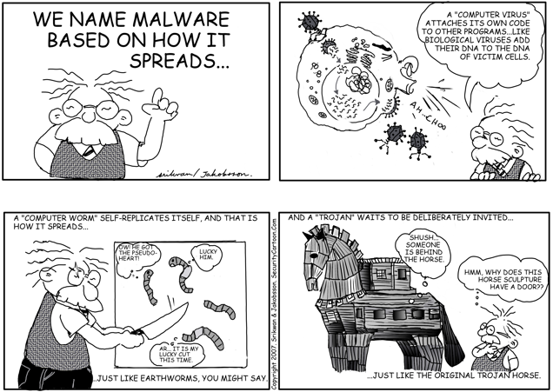
Reproduced with permission. Please visit www.SecurityCartoon.com for more material
Notes:
the Colonial Pipeline attack, Kaseya ransomware attack, and the SolarWinds Dark Halo breach.

Slide 23
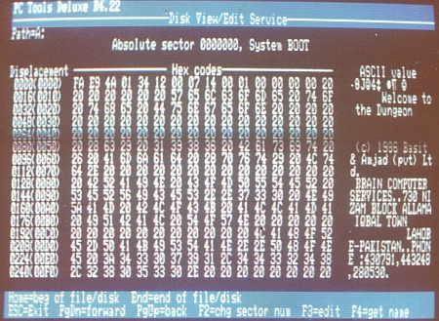
The first computer virus
Brain Virus (Pakistani Flu) 1986
Credit: http://en.wikipedia.org/wiki/Brain_(computer_virus)

Slide 24
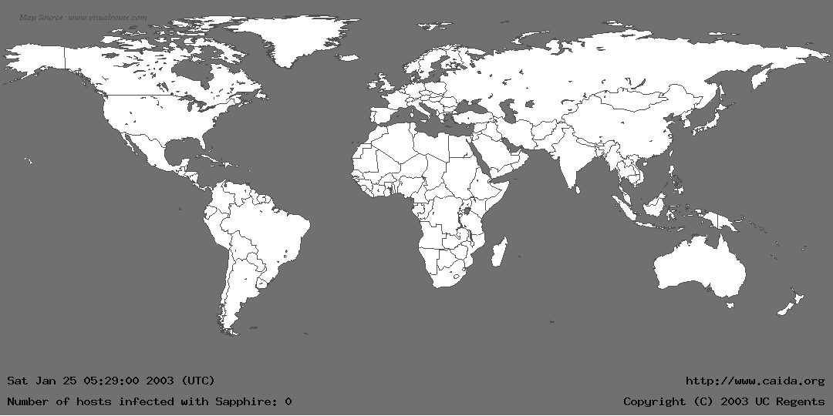
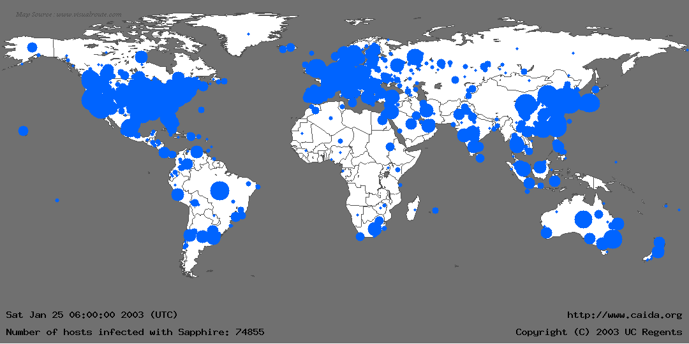
Propagation effect of worms
The Sapphire Worm (also called SQL Slammer) was the fastest computer worm in history. As it began spreading throughout the Internet, it doubled in size every 8.5 seconds. It infected more than 90 percent of vulnerable hosts within 10 minutes.
After slammer worm
Before slammer worm
Credit: Yashar Ganjali; www.caida.org
Notes:
From: http://www.caida.org/publications/papers/2003/sapphire/sapphire.html
The Sapphire Worm (also called Slammer) was the fastest computer worm in history. As it began spreading throughout the Internet, it doubled in size every 8.5 seconds. It infected more than 90 percent of vulnerable hosts within 10 minutes.
The worm began to infect hosts slightly before 05:30 UTC on Saturday, January 25. Sapphire exploited a buffer overflow vulnerability in computers on the Internet running Microsoft's SQL Server or MSDE 2000 (Microsoft SQL Server Desktop Engine). This weakness in an underlying indexing service was discovered in July 2002; Microsoft released a patch for the vulnerability before it was announced[1]. The worm infected at least 75,000 hosts, perhaps considerably more, and caused network outages and such unforeseen consequences as canceled airline flights, interference with elections, and ATM failures. Several disassembled versions of the source code of the worm are available. [2].

Slide 25
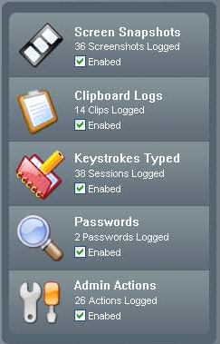
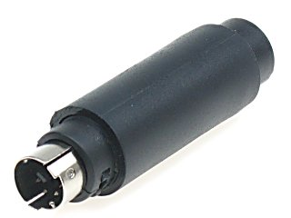

Key-loggers and Spyware
Notes:
http://www.alibaba.com/product/prolech-11475911-10943255/KeyShark_Hardware_Keylogger.html
http://www.illinoisicac.org/images/spy.gif

Slide 26

Spoofing Attacks
b
where the attacker impersonates some one else
Email spoofing
URL spoofing
DNS spoofing
IP spoofing
MAC spoofing

Slide 27
Email Spoofing (phishing)
b.1
Attacker changes the “from” address to a random address
Email origin is lost

Slide 28
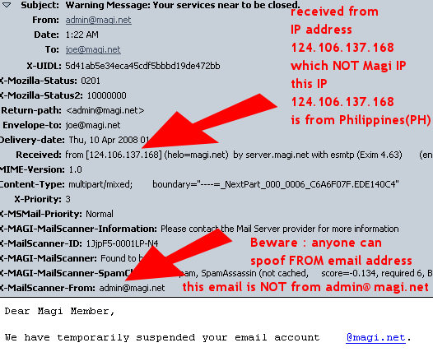

Slide 29

URL Spoofing (phishing)
b.2

Slide 30

1
https://mail.seecs.edu.pk/src/login.php
Genuine URL;
Site: seecs.edu.pk; directory: src;
file: login.php

Slide 31

https://webmail.niit.org.pk/src/login.php
https://mail.seecs.org.pk/src/login.php
2
The second-level domain is .org and not .edu; faked website
HACKED
HACKED
HACKED
Victim.ID
**************

Slide 32
https://mail.seecs.edu.tk/src/login.php
https://webmail.niit.edu.tk/src/login.php
The first-level domain is .tk and not .pk; faked website
3
HACKED
HACKED
HACKED
Victim.ID
**************

Slide 33
https://202.128.111.87/src/login.php
https://202.125.111.57/src/login.php
The IP address does not correspond to mail.seecs.edu.pk; faked website
HACKED
HACKED
HACKED
4
Victim.ID
**************

Slide 34
DNS Spoofing
b.3
b.4
IP Spoofing
b.5
MAC Spoofing

Slide 35

DNS spoofing
DNS
WWW
Request
WWW
Tell me the IP address of seecs.nust.edu.pk?
Notes:
Hacker image from: http://english.vietnamnet.vn/dataimages/200611/original/images1168407_hacker.jpg

Slide 36
DNS spoofing
DNS
WWW
Reply
WWW
The IP address of seecs.nust.edu.pk is 110.125.157.198
The IP address of seecs.nust.edu.pk is 110.125.157.198
Fake SEECS site

Slide 37
MAC/ IP spoofing
Private network
192.168.1.0/24
00:aa:bb:cc:dd:ee:ff
.254
…
Malicious node
.1
.254
A malicious node can pretend to be another node
00:aa:bb:cc:dd:ee:ff
Notes:
IP spoofing is pretending to have someone else’s IP address.
In the scenario above, it can be that that private network is configured to allow only limited access (based on IP address or MAC address).
An intruding/ malicious node can attack both by claiming to have an IP address/ and or MAC address it does not have.

Slide 38
Network-based attacks
c
Choking the networks so that node are unable to get service
Denial of Service attacks

Slide 39

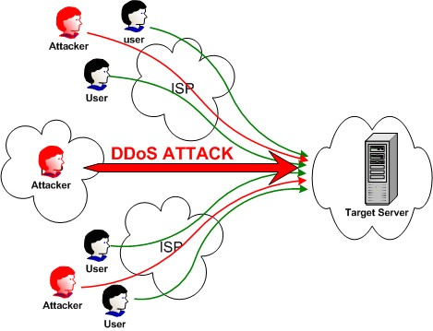
Denial of Service attacks
http://1.bp.blogspot.com/_TUZOJcmlBhM/TR2oI-IQzlI/AAAAAAAAADQ/WoiW_gT3nGk/s1600/DOS.jpg
Notes:
http://www.ddosinfo.com/images/Attack%20of%20the%20bots_1.jpg
http://cyberwarfaremag.files.wordpress.com/2008/11/computer-worm-01.jpg

Slide 40
Social Engineering
d
Targets the weakest component of a security system---the users

Slide 41
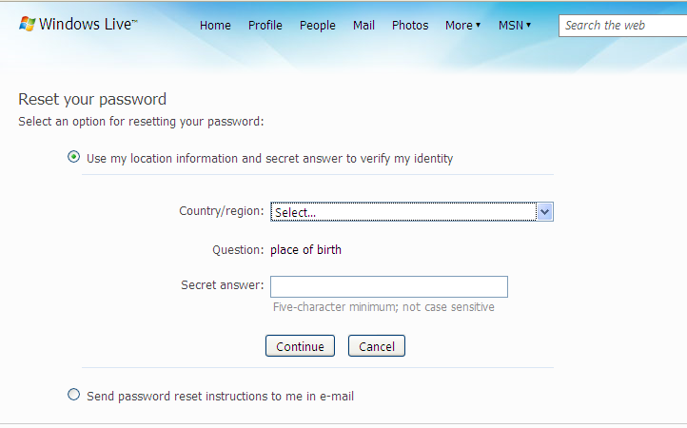
Non-technical hacking

Slide 42
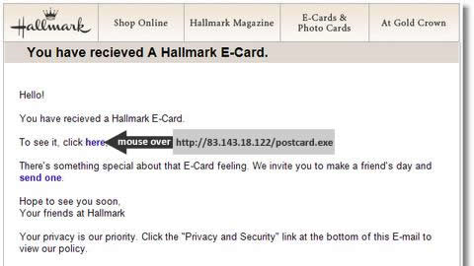
Greeting card phishing
Notes:
http://blog.activeservers.com/content/binary/hallmark2.jpg

Slide 43

Lottery winning phishing
Notes:
http://www.millersmiles.co.uk/report/2698

Slide 44
Topics
Encoding
Framing
Error detection
Reliable delivery
Access Mediation
Notes:
We have covered up till now that if we want to build a direct-link network (in which all nodes are connected together by one or more direct links – i.e., there are no switches), we have to cover five fundamental problems. These problems are listed above.
Encoding is primarily a layer 1 function but is implemented in network adapters. The encoding functionality converts data bits into signal form that can be sent on the physical medium. Framing is essential a layer-2 function and is also performed by a network adapter – the framing functionality is responsible mainly for determining the frame boundaries, and also contains addressing information.
However, there are other important functionalities that must be implemented if we want to make our direct link network useful. More specifically, we should have the ability to mediate requests for access to the network; this is necessary since physical links cannot accommodate arbitrary number of users. When multiple users want to transmit at the same time, the media access control (MAC) protocol must decide which node can transmit and which node should wait.
Our lecture today would be on access mediation techniques in networks. We will study access mediation for both wired and wireless networks. Note that we do not need to perform media access mediation on a point-to-point link assuming full-duplex links. PPP, however, assumes full-duplex links as is stated in the PPP RFC. (To know what an RFC is, see: http://en.wikipedia.org/wiki/Request_for_Comments)
With the assumption, that point-to-point links are full duplex, the MAC problem is relevant to multiple access networks. We have already named one example of a multiple-access network which is Ethernet (without delving into too much details). Ethernet is an example of a wired network, we will also study today the MAC problem for wireless networks. We will see that wireless networks have different characteristics than wired networks.

Slide 45
Encoding
The first step in turning nodes and links into usable building blocks is to understand how to connect them in such a way that bits can be transmitted from one node to the other.
Since it is actually signals that propagate over physical links. The binary data that the source node wants to send, therefore, has to be encoded.
Bits are encoded into the signals that the links are able to carry, and the signal has to be decoded back into the corresponding binary data at the receiving node.
Notes:
It should be clear by now that a major goal in designing error detection algorithms is to maximize the probability of detecting errors using only a small number of redundant bits.
We ignore the details of modulation and assume we are working with two discrete signals: high and low. In practice, these signals might correspond to two different voltages on a copper-based link, or two different power levels on an optical link.
As we have said, most of the functions discussed during our lectures on Data-link protocols are performed by a network adaptor—a piece of hardware that connects a node to a link. The network adaptor contains a signaling component that actually encodes bits into signals at the sending node and decodes signals into bits at the receiving node. Thus, as illustrated in the figure shown above, signals travel over a link between two signaling components, and bits flow between network adaptors.

Slide 46
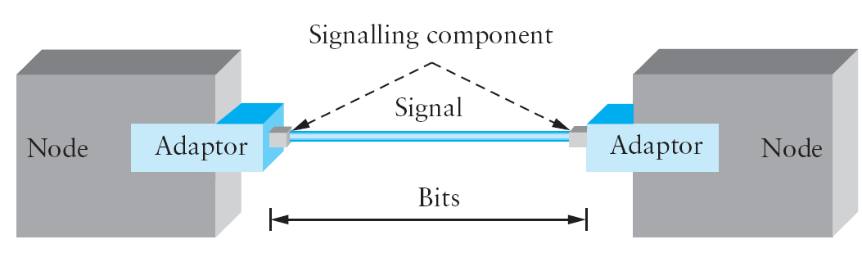
Encoding
Adaptor—a piece of hardware that connects a node to a link. The network adaptor contains a signaling component that actually encodes bits into signals at the sending node and decodes signals into bits at the receiving node.
Figure shows that signals travel over a link between two signaling components, and bits flow between network adaptors.
Notes:
The first step in turning nodes and links into usable building blocks is to understand how to connect them in such a way that bits can be transmitted from one node to the other. Since it is actually signals that propagate over physical links. The binary data that the source node wants to send, therefore, has to be It should be clear by now that a major goal in designing error detection algorithms is to maximize the probability of detecting errors using only a small number of redundant bits. encoded into the signals that the links are able to carry, and the signal has to be decoded back into the corresponding binary data at the receiving node.
We ignore the details of modulation and assume we are working with two discrete signals: high and low. In practice, these signals might correspond to two different voltages on a copper-based link, or two different power levels on an optical link.
As we have said, most of the functions discussed during our lectures on Data-link protocols are performed by a network

Slide 47
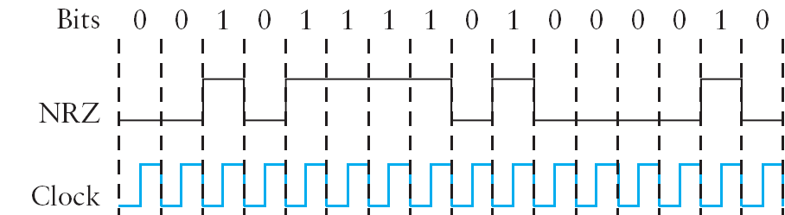
NRZ (Non-return to zero)
Receiver keeps average signal seen so far
Significantly higher than average = 1
Significantly lower than average = 0
Long periods of Low/High Changes average
Makes it harder to detect significant changes
Notes:
Let’s return to the problem of encoding bits onto signals. The obvious thing to do is to map the data value 1 onto the high signal and the data value 0 onto the low signal. This is exactly the mapping used by an encoding scheme called, cryptically enough, non-return to zero (NRZ). For example, the figure above schematically depicts the NRZ-encoded signal (bottom) that corresponds to the transmission of a particular sequence of bits (top).
The problem with NRZ is that a sequence of several consecutive 1s means that the signal stays high on the link for an extended period of time, and similarly, several consecutive 0s means that the signal stays low for a long time. There are two fundamental problems caused by long strings of 1s or 0s. The first is that it leads to a situation known as baseline wander. Specifically, the receiver keeps an average of the signal it has seen so far, and then uses this average to distinguish between low and high signals. Whenever the signal is significantly lower than this average, the receiver concludes that it has just seen a 0, and likewise, a signal that is significantly higher than the average is interpreted to be a 1. The problem, of course, is that too many consecutive 1s or 0s cause this average to change, making it more difficult to detect a significant change in the signal.
The second problem follows in the next slide:

Slide 48
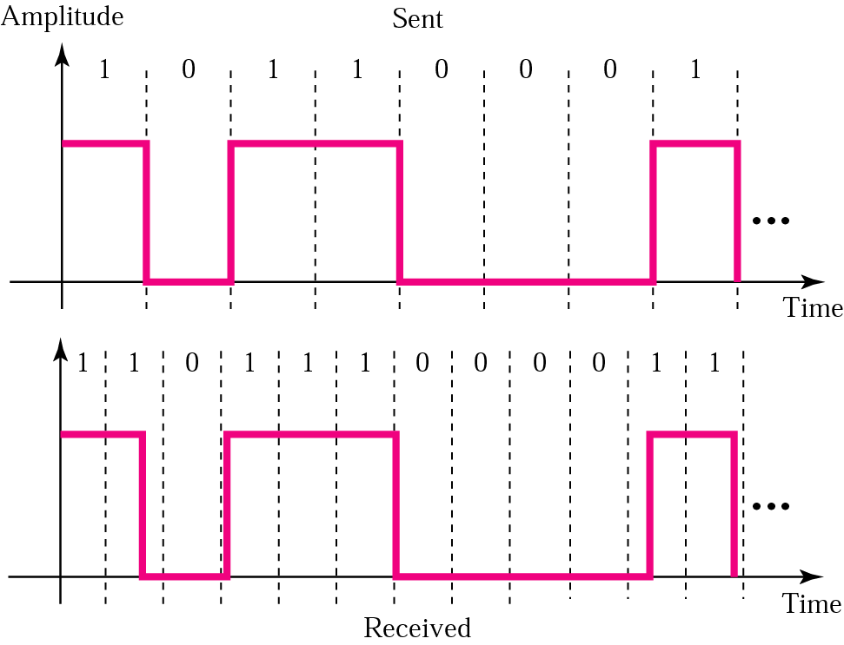
Problems due to “Clock drift”
The sender’s and the receiver’s clocks have to be precisely synchronized in order for the receiver to recover the same bits the sender transmits. If the receiver’s clock is even slightly faster or slower than the sender’s clock, then it does not correctly decode the signal.
Notes:
In digital transmission, Bit slip is the loss of a bit or bits, caused by clock drift – variations in the respective clock rates of the transmitting and receiving devices.
The second problem is that frequent transitions from high to low and vice versa are necessary to enable clock recovery. Intuitively, the clock recovery problem is that both the encoding and the decoding processes are driven by a clock—every clock cycle the sender transmits a bit and the receiver recovers a bit. The sender’s and the receiver’s clocks have to be precisely synchronized in order for the receiver to recover the same bits the sender transmits. If the receiver’s clock is even slightly faster or slower than the sender’s clock, then it does not correctly decode the signal. You could imagine sending the clock to the receiver over a separate wire, but this is typically avoided because it makes the cost of cabling twice as high. So instead, the receiver derives the clock from the received signal—the clock recovery process.

Slide 49
Problems due to “Clock drift”
Whenever the signal changes, such as on a transition from 1 to 0 or from 0 to 1, then the receiver knows it is at a clock cycle boundary, and it can resynchronize itself. However, a long period of time without such a transition leads to clock drift. Thus, clock recovery depends on having lots of transitions in the signal, no matter what data is being sent.
Notes:
In digital transmission, Bit slip is the loss of a bit or bits, caused by clock drift – variations in the respective clock rates of the transmitting and receiving devices.
The second problem is that frequent transitions from high to low and vice versa are necessary to enable clock recovery. Intuitively, the clock recovery problem is that both the encoding and the decoding processes are driven by a clock—every clock cycle the sender transmits a bit and the receiver recovers a bit. The sender’s and the receiver’s clocks have to be precisely synchronized in order for the receiver to recover the same bits the sender transmits. If the receiver’s clock is even slightly faster or slower than the sender’s clock, then it does not correctly decode the signal. You could imagine sending the clock to the receiver over a separate wire, but this is typically avoided because it makes the cost of cabling twice as high. So instead, the receiver derives the clock from the received signal—the clock recovery process.

Slide 50
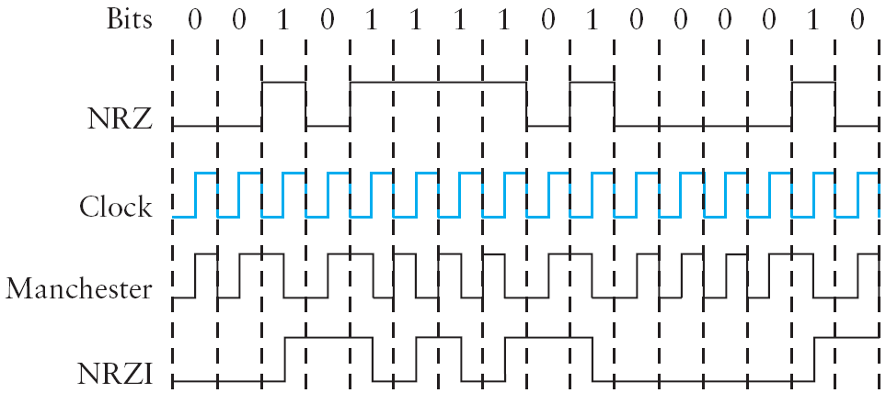
NRZ-I Encoding
Transition because next bit is a 1
Notes:
One approach that addresses the “clock drift” problem, called non-return to zero inverted (NRZI), has the sender make a transition from the current signal to encode a 1 and stay at the current signal to encode a 0. This solves the problem of consecutive 1s, but obviously does nothing for consecutive 0s.

Slide 51
4B/5B Block Coding
Code every 4 bits of actual data in 5 bit code ensuring:
Avoid consecutive runs of 0s
E.g., 0000 replaced by 11110
In the transmitted bit stream, no more than 3 0s
Resulting 5-bit code transmitted using NRZI
which already takes care of series of 1s
Notes:
A final encoding that we consider, called 4B/5B, attempts to address the inefficiency of the Manchester encoding without suffering from the problem of having extended durations of high or low signals. The idea of 4B/5B is to insert extra bits into the bit stream so as to break up long sequences of 0s or 1s. Specifically, every 4 bits of actual data are encoded in a 5-bit code that is then transmitted to the receiver; hence the name 4B/5B. The 5-bit codes are selected in such a way that each one has no more than one leading 0 and no more than two trailing 0s. Thus, when sent back-to-back, no pair of 5-bit codes results in more than three consecutive 0s being transmitted. The resulting 5-bit codes are then transmitted using the NRZI encoding, which explains why the code is only concerned about consecutive 0s—NRZI already solves the problem of consecutive 1s. Note that the 4B/5B encoding results in 80% efficiency.

Slide 52
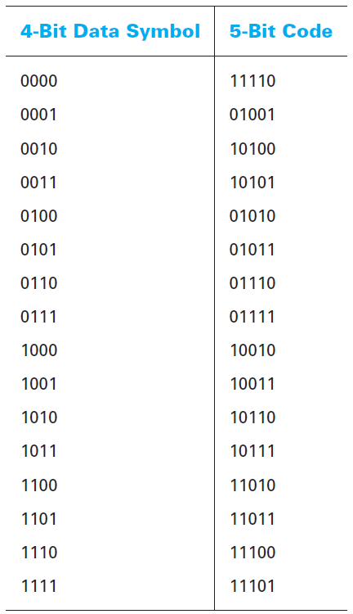
The 5-bit codes are selected in such a way that each one has no more than one leading 0 and no more than two trailing 0s. Thus, when sent back-to-back, no pair of 5-bit codes results in more than three consecutive 0s being transmitted.
These 5 bit words are pre-determined in a dictionary and they are chosen to ensure that there will be sufficient transitions in the line state to produce a self-clocking signal
Notes:
A final encoding that we consider, called 4B/5B, attempts to address the inefficiency of the Manchester encoding without suffering from the problem of having extended durations of high or low signals. The idea of 4B/5B is to insert extra bits into the bit stream so as to break up long sequences of 0s or 1s. Specifically, every 4 bits of actual data are encoded in a 5-bit code that is then transmitted to the receiver; hence the name 4B/5B. The 5-bit codes are selected in such a way that each one has no more than one leading 0 and no more than two trailing 0s. Thus, when sent back-to-back, no pair of 5-bit codes results in more than three consecutive 0s being transmitted. The resulting 5-bit codes are then transmitted using the NRZI encoding, which explains why the code is only concerned about consecutive 0s—NRZI already solves the problem of consecutive 1s. Note that the 4B/5B encoding results in 80% efficiency.

Slide 53
Manchester Coding
Transition for 0
(like a clock pulse)
Transition for 1
(inverse of a clock pulse)
Self Clocking Encoding
Notes:
An alternative, called Manchester encoding, does a more explicit job of merging the clock with the signal by transmitting the exclusive-OR of the NRZ-encoded data and the clock.
Manchester is an NRZ encoding that is exclusively-ORed with the clock. This provides at least one transition per bit. NRZI also uses a transition in the middle of the clock cycle, but this only occurs when there is a 1 value. Manchester makes clock recovery easier.

Slide 54
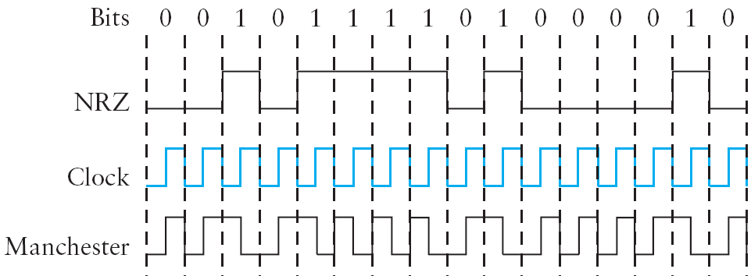
Manchester Coding
Notes:
An alternative, called Manchester encoding, does a more explicit job of merging the clock with the signal by transmitting the exclusive-OR of the NRZ-encoded data and the clock.
(Think of the local clock as an internal signal that alternates from low to high; a low/high pair is considered one clock cycle.) The Manchester encoding is also illustrated in the figure above. Observe that the Manchester encoding results in 0 being encoded as a low-to-high transition and 1 being encoded as a high-to-low transition. Because both 0s and 1s result in a transition to the signal, the clock can be effectively recovered at the receiver.
Problem: The problem with the Manchester encoding scheme is that it doubles the rate at which signal transitions are made on the link, which means that the receiver has half the time to detect each pulse of the signal. The rate at which the signal changes is called the link’s baud rate. In the case of the Manchester encoding, the bit rate is half the baud rate, so the encoding is considered only 50% efficient. Keep in mind that if the receiver had been able to keep up with the faster baud rate required by the Manchester encoding in the figure above, then both NRZ and NRZI could have been able to transmit twice as many bits in the same time period.
(There is also a variant of the Manchester encoding, called differential Manchester, in which a 1 is encoded with the first half of the signal equal to the last half of the previous bit’s signal and a 0 is encoded with the first half of the signal opposite to the last half of the previous bit’s signal.)

Slide 55
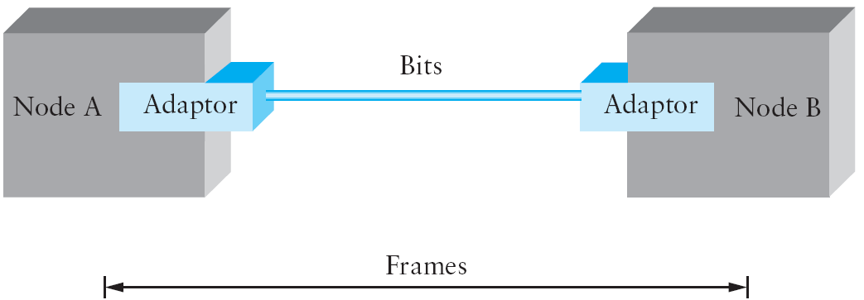
Framing (Blocks of Data)
Synchronous and Asynchronous Transmission
Asynchronous protocols treat each character in a bit stream independently. Synchronous protocols take the whole bit stream and chop it into characters of equal size.
Notes:
ASYNCHRONOUS VS. SYNCHRONOUS COMMUNICATION:
Asynchronous protocols are employed mainly in modems. Due to its inherent slowness (stemming from the requirement of addition of start/ stop bits and extended spaces between frames), asynchronous communication is rapidly being replaced by synchronous communication.
Synchronous protocols:
The speed of synchronous transmission makes it a better choice over asynchronous transmission for LAN, MAN and WAN technology. Protocols governing synchronous transmission can be further divided into two classes: 1) character oriented protocols and 2) bit oriented protocols.
In this lecture, from here forth, we are only going to focus on synchronous communication and its two major types: 1) byte-oriented framing; 2) character-oriented framing.
What is Framing: Since we are focusing on packet-switched networks, which means that blocks of data (called frames at this level), not bit streams, are exchanged between nodes. It is the network adaptor that enables the nodes to exchange frames.
Central challenge: When node A wishes to transmit a frame to node B, it tells its adaptor to transmit a frame from the node’s memory. This results in a sequence of bits being sent over the link. The adaptor on node B then collects together the sequence of bits arriving on the link and deposits the corresponding frame in B’s memory. Recognizing exactly what set of bits constitutes a frame—that is, determining where the frame begins and ends—is the central challenge faced by the adaptor.
There are several ways to address the framing problem. We will discuss different protocols to illustrate the various points in the design space. Note that while we discuss framing in the context of point-to-point links, the problem is a fundamental one that must also be addressed in multiple-access networks like Ethernet and token rings.

Slide 56
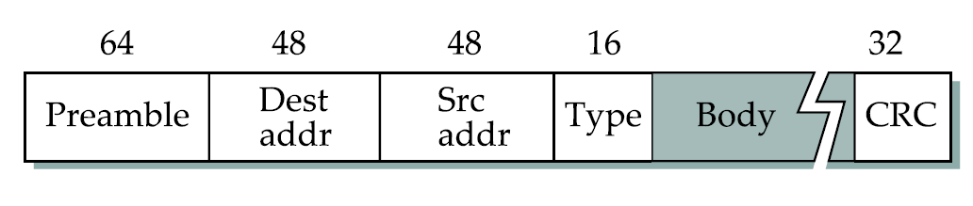
The frame format used by Ethernet protocol
Figure Credit: “Computer Networks: A Systems Approach” by Peterson and Davie
Notes:
STDM
FDM
Statistical Multiplexing
Issues of QoS and Congestion.
The preamble of an Ethernet packet consists of a 64-bit pattern of alternating 1 and 0 bits, allowing devices on the network to easily synchronize their receiver clocks, which is followed by the SFD to mark a new incoming frame

Slide 57
Framing (Blocks of Data)
It is the network adaptor that enables the nodes to exchange frames.
Central challenge: When node A wishes to transmit a frame to node B, it tells its adaptor to transmit a frame from the node’s memory. This results in a sequence of bits being sent over the link. The adaptor on node B then collects together the sequence of bits arriving on the link and deposits the corresponding frame in B’s memory. Recognizing exactly what set of bits constitutes a frame—that is, determining where the frame begins and ends—is the central challenge faced by the adaptor.
Notes:
ASYNCHRONOUS VS. SYNCHRONOUS COMMUNICATION:
Asynchronous protocols are employed mainly in modems. Due to its inherent slowness (stemming from the requirement of addition of start/ stop bits and extended spaces between frames), asynchronous communication is rapidly being replaced by synchronous communication.
Synchronous protocols:
The speed of synchronous transmission makes it a better choice over asynchronous transmission for LAN, MAN and WAN technology. Protocols governing synchronous transmission can be further divided into two classes: 1) character oriented protocols and 2) bit oriented protocols.
In this lecture, from here forth, we are only going to focus on synchronous communication and its two major types: 1) byte-oriented framing; 2) character-oriented framing.
What is Framing: Since we are focusing on packet-switched networks, which means that blocks of data (called frames at this level), not bit streams, are exchanged between nodes. It is the network adaptor that enables the nodes to exchange frames.
Central challenge: When node A wishes to transmit a frame to node B, it tells its adaptor to transmit a frame from the node’s memory. This results in a sequence of bits being sent over the link. The adaptor on node B then collects together the sequence of bits arriving on the link and deposits the corresponding frame in B’s memory. Recognizing exactly what set of bits constitutes a frame—that is, determining where the frame begins and ends—is the central challenge faced by the adaptor.
There are several ways to address the framing problem. We will discuss different protocols to illustrate the various points in the design space. Note that while we discuss framing in the context of point-to-point links, the problem is a fundamental one that must also be addressed in multiple-access networks like Ethernet and token rings.

Slide 58
The 802.11 MAC Layer Services: Wired Equivalent Privacy (WEP)
Suppose that we want to send three different data bits such as: 11011101 ,10111011 and 11101110 by using a key stream of 10101010. Prove that XOR of the plaintexts is equal to XOR of the cipher-texts and generate the key-stream by supposing that you know the original text. [Extra credit for first two students]

Slide 59
[ End of lecture ]

